Slide 1

Machine Learning Project Presentation
Topic :
Richter’s Predictor Modeling Earthquake Challenge hosted by DRIVENDATA.
Notes:
Source images : Powerpoint Stock Images

Slide 2
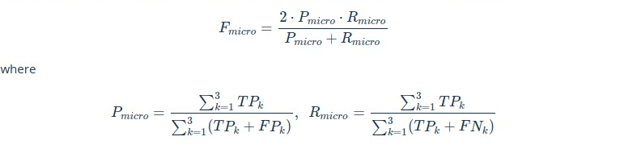
Performance Metric
Notes:
Source images : https://unsplash.com/photos/aWf7mjwwJJo ( Medienstürmer on Unsplash )

Slide 3


Machine Learning models
Score
Model Used
Training Time
Rank
Classification Accuracy
Random Forest
1:38
675/5462
0.7327
Decision Tree
2s
1295/5462
0.6555
0.5900
Logistic Regression
3s
LOW
0.6578
KNN
45s
1220/5462

Slide 4
Fine Tuning XGBoost
Score
Model Used
Average Training Time
Rank
Classification Accuracy
Xgboost #1
5:30
970/5462
0.7325
Xgboost #2
7:12
911/5462
0.7377
0.7407
Xgboost #3
6:34
511/5462
0.7429
Xgboost #4
7:19
460/5462

Slide 5
Deep Learning Vs The Rest
Score
Model Used
Training Time
Rank
Classification Accuracy
0.7526
RNN + LightGBM
32:22
30/5462
Xgboost (the best)
7:19
460/5462
0.7429
0.7327
Random Forest
1:38
675/5462

Slide 6
Conclusion
Notes:
Source images : Powerpoint Stock Images

